Slide 1

ScreenSense – Kids’ Screentime Visualization
Milestones 1 to 4 – Final Presentation
Name: Harshit Pandey
Email: pandeyharshit7277@gmail.com

Slide 2
Project Statement
Our Objective: Analyze kids’ screentime patterns to uncover trends by:
Age
Gender
Device type
Urban/Rural
Weekday vs Weekend
Activity Category
Purpose: Provide insights that help parents, educators, and policymakers understand digital habits.

Slide 3
Dataset & Modules
Dataset:
Source: Kaggle (Indian Kids Screentime 2025)
9712 records, 8+ attributes
Modules Implemented:
Data Acquisition
Cleaning & Feature Engineering
Univariate & Bivariate Analysis
Device & Activity Mix Analysis
Weekday vs Weekend Trends
Demographic Insights
Dashboard Creation
Presentation & Documentation

Slide 4
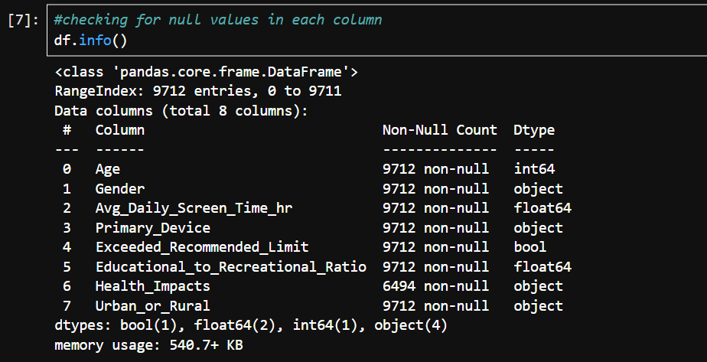
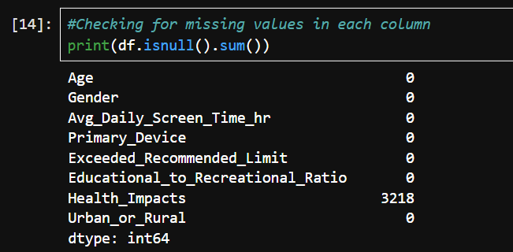
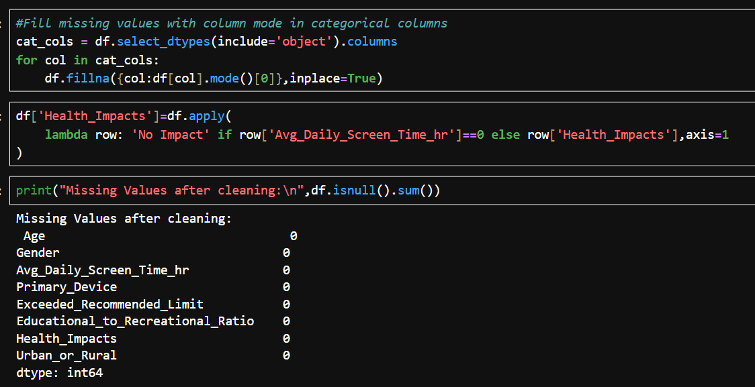
Milestone 1: Data Foundation & Cleaning
Week 1 – Understanding the Dataset
Loaded dataset
Checked schema, types, nulls
Explored summary stats
Week 2 – Cleaning & Feature Engineering
Filled missing values
Cleaned inconsistent text
Created:
Age Bands
Usage Levels
Is_Urban flag
Educational & Recreational shares

Slide 5
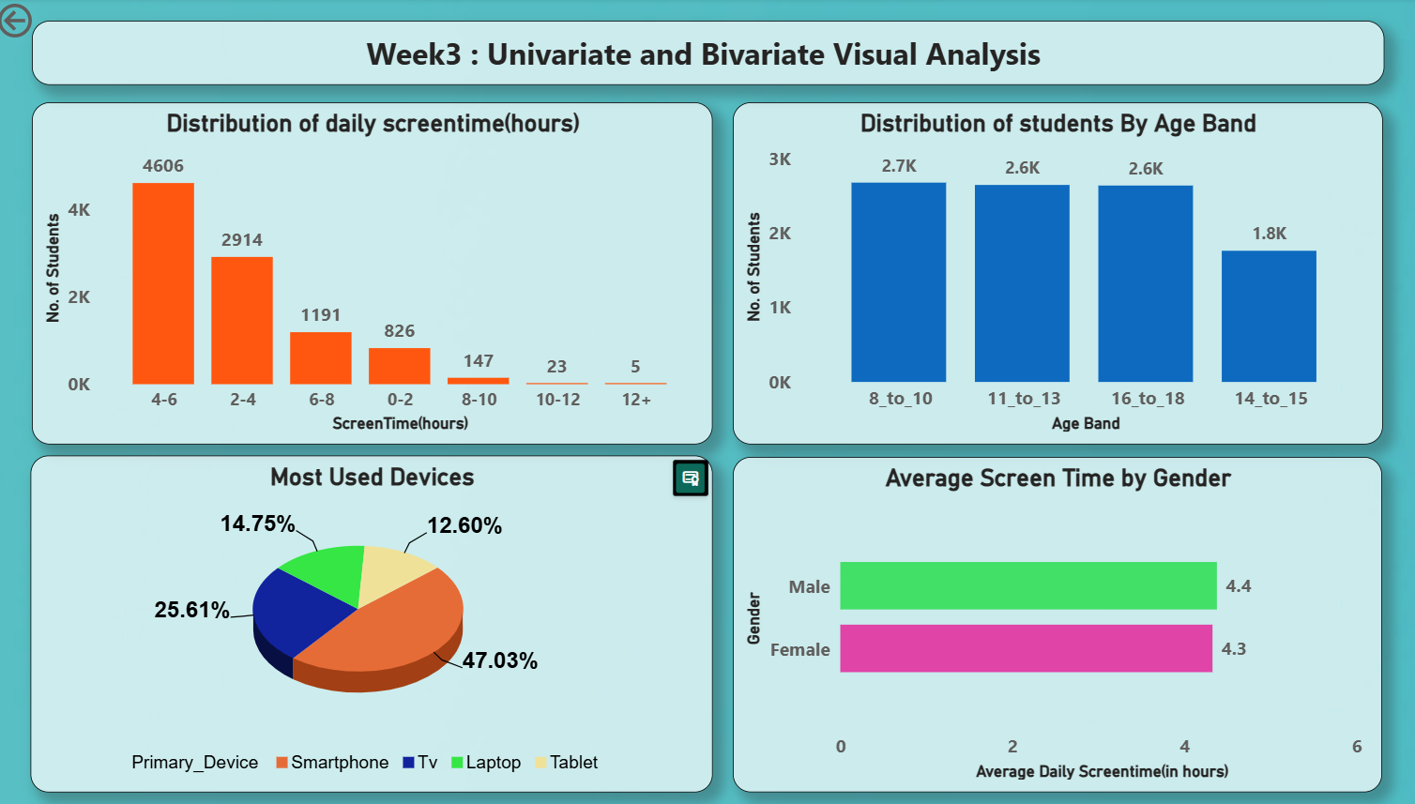
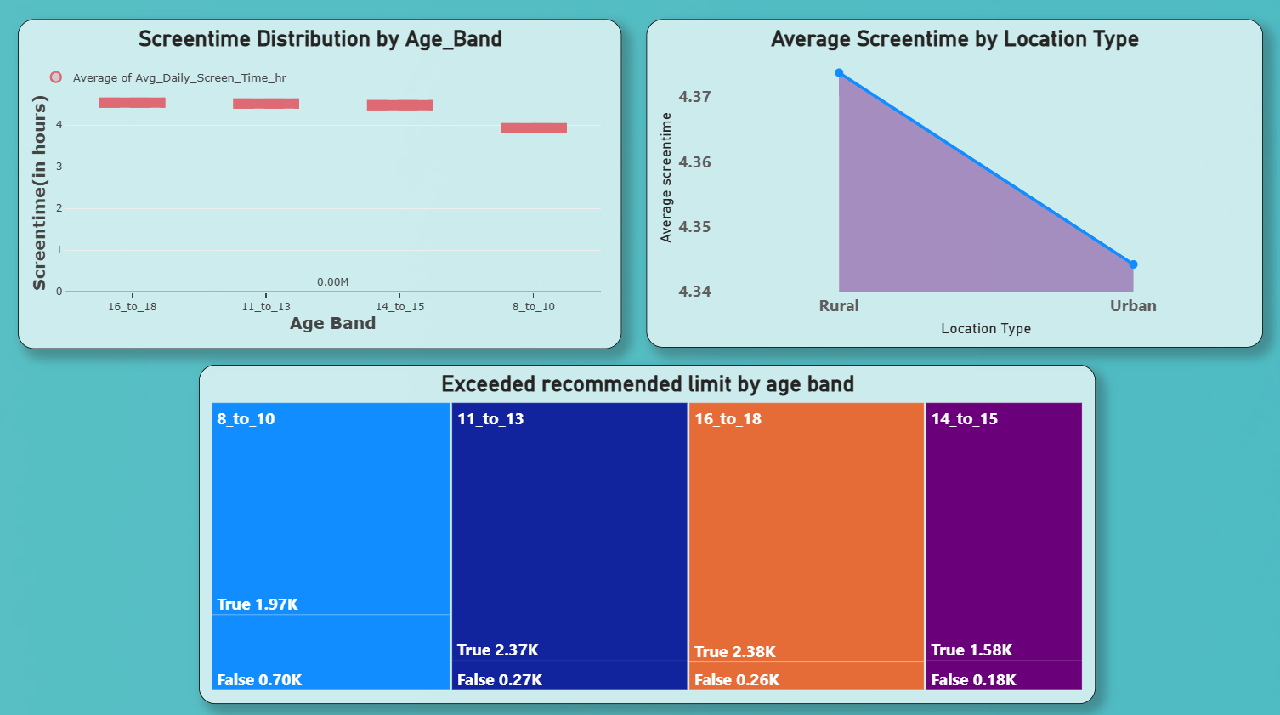
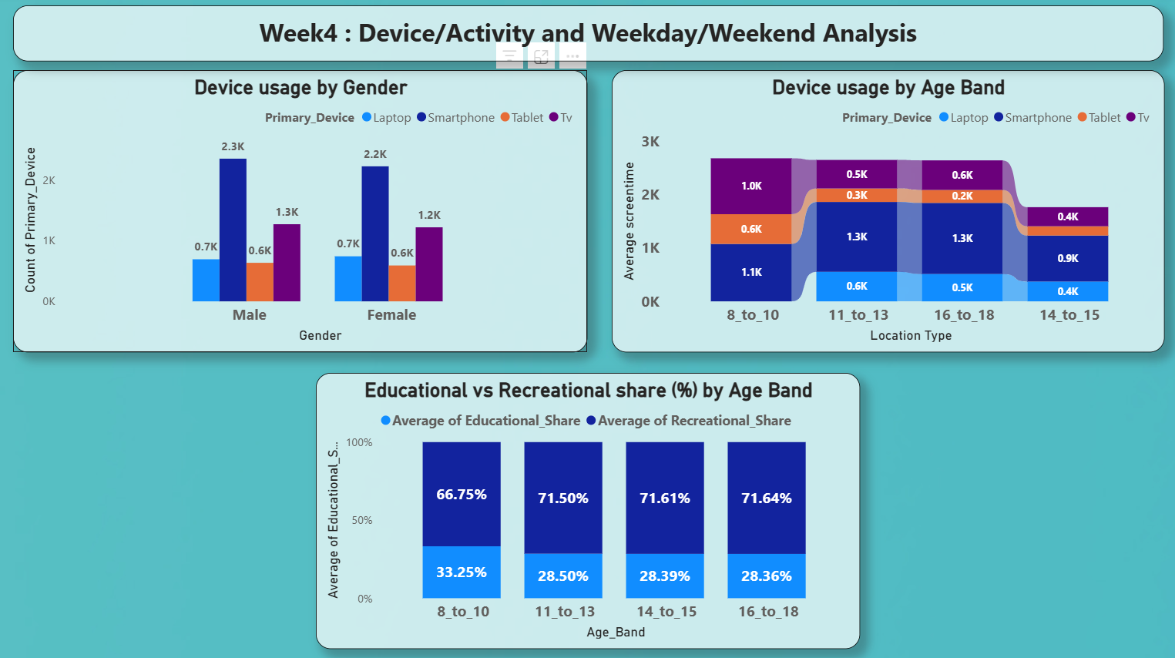
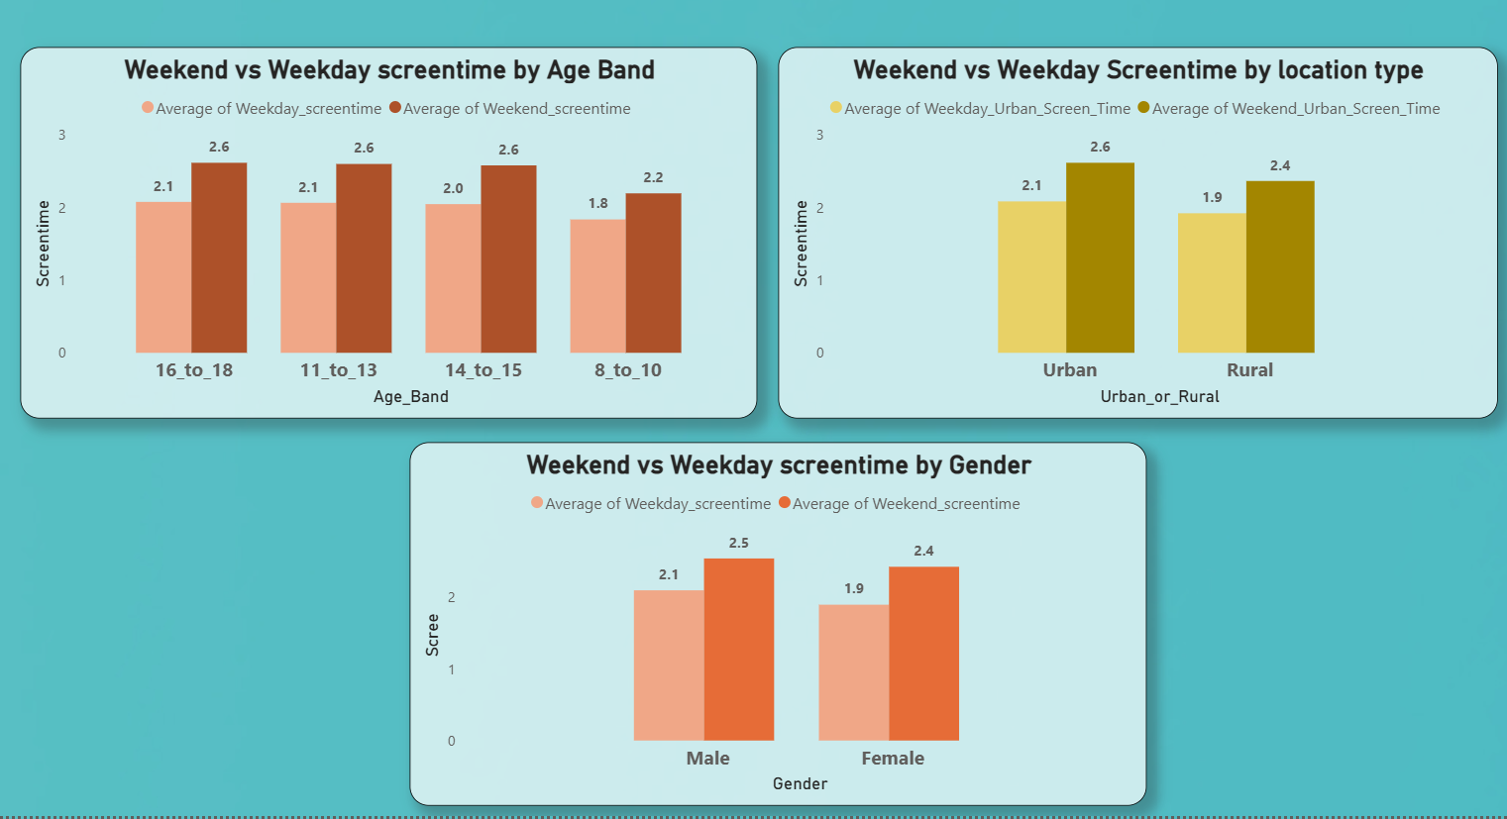
Milestone 2: Visual Exploration
Week 3 – Univariate & Bivariate Analysis
Screentime distribution
Device usage patterns
Gender, Age, Location comparisons
Week 4 – Device & Activity Patterns
Device mix by age and gender
Educational vs Recreational trends
Weekday vs weekend analysis

Slide 6
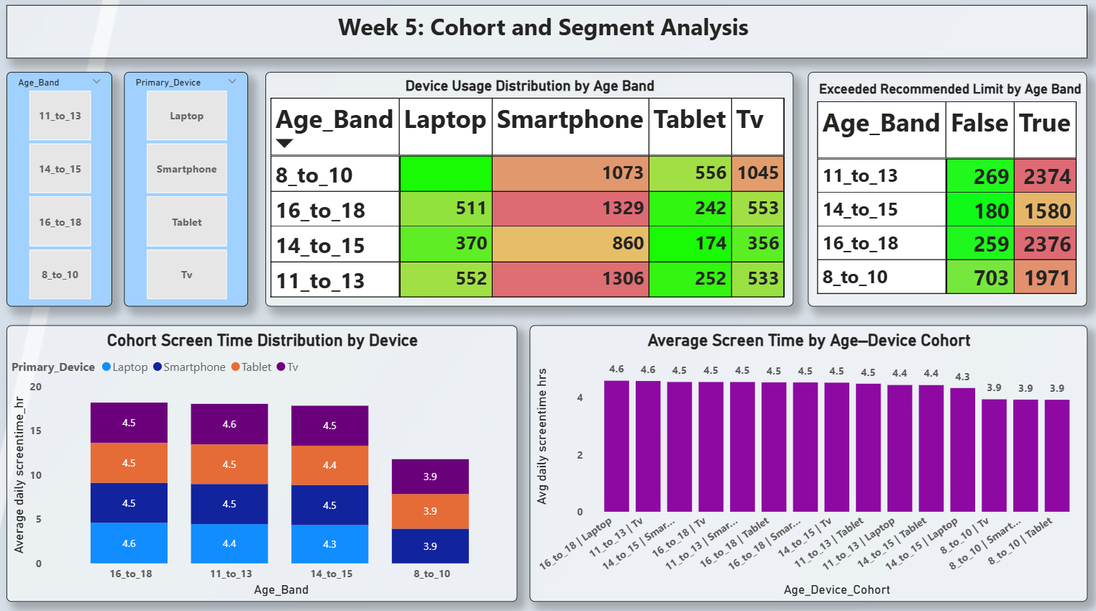
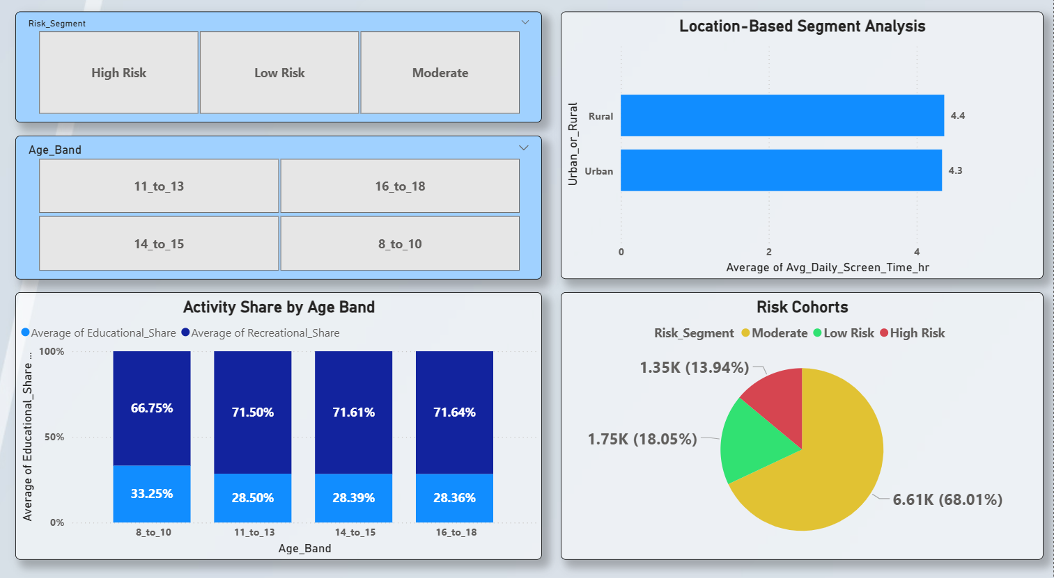
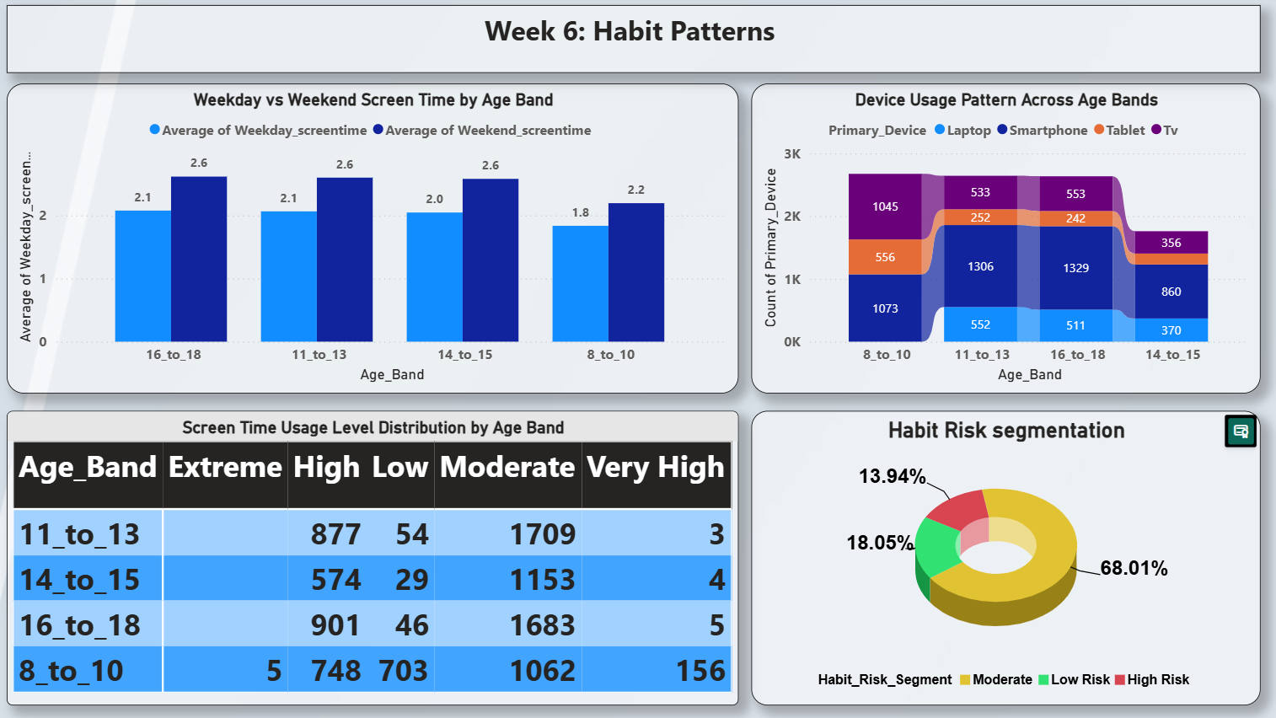
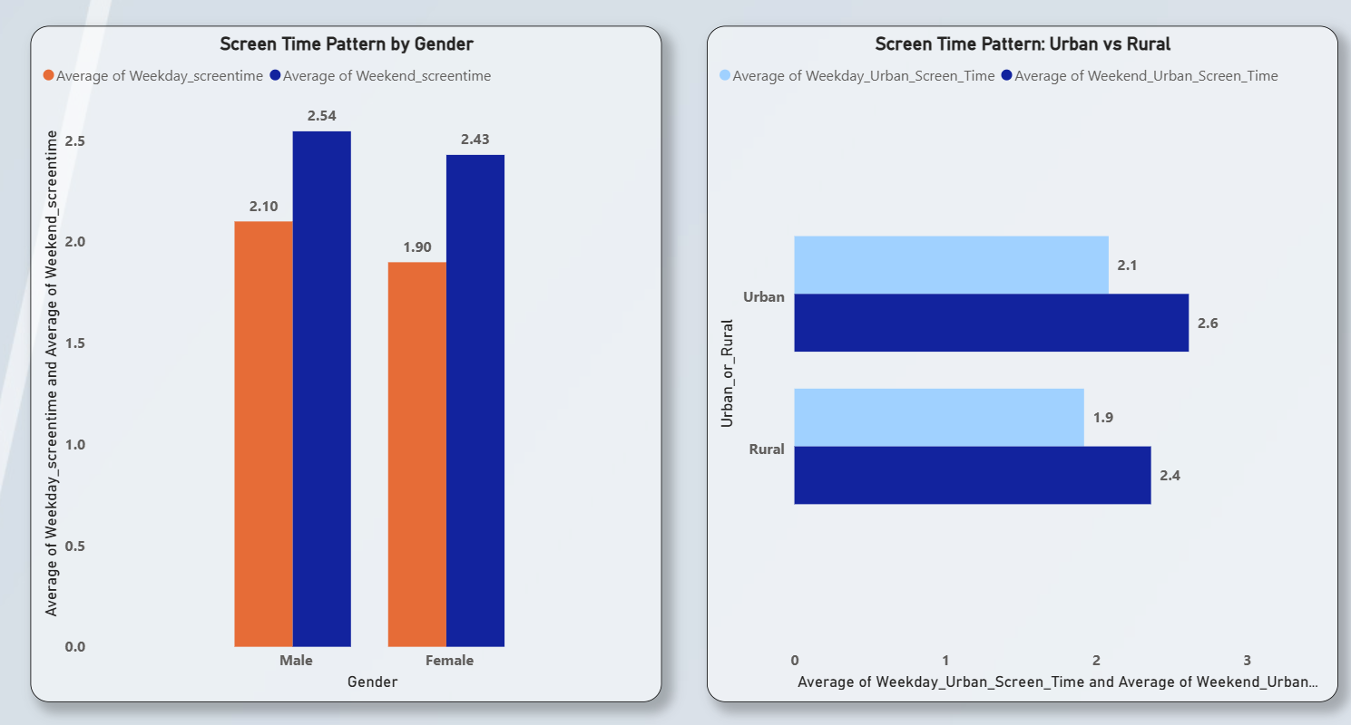
Milestone 3: Cohort & Segment Insights
Week 5 – Cohort Analysis
Device × Age Band patterns
Heatmaps for limit exceeders
Top cohorts identified
Week 6 – Habit Patterns
Weekend spikes
Usage levels (Low–Extreme)
Risk segmentation

Slide 7
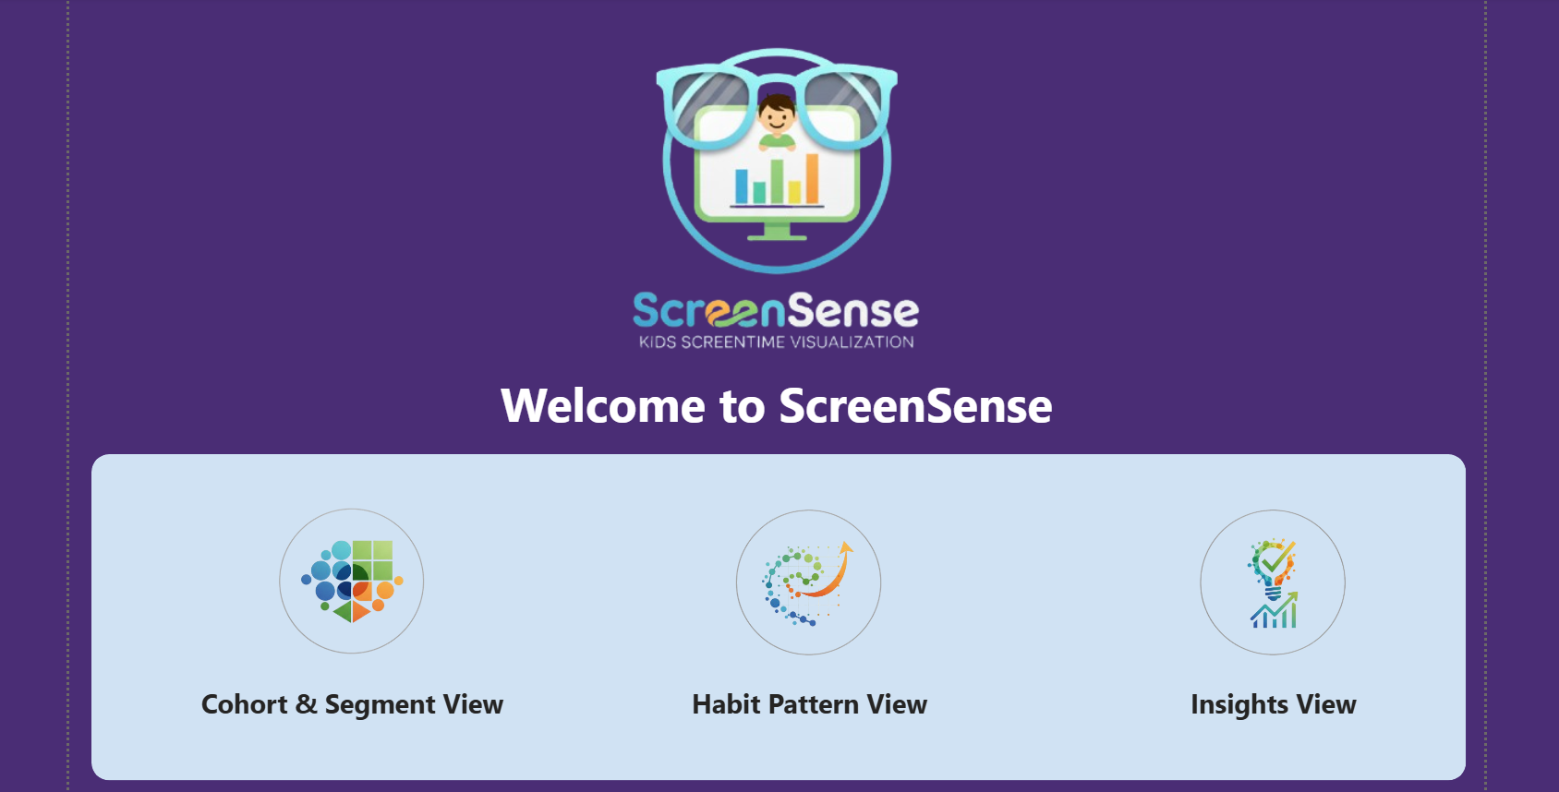
Milestone 4: Final Dashboard
Week 7 – Dashboard Build
Built interactive Power BI dashboard
Added slicers: Age, Gender, Device, Location, Risk
Created KPI cards & layout
Designed navigation pages
Dashboard Pages:
Home Page
Cohort & Segment Analysis
Habit Pattern Analysis
Summary & Insights

Slide 8
Key Insights
Major Findings:
Avg screentime ≈ 4.35 hours
85% students exceed recommended limit
Smartphones = most used device (47%)
Recreational usage ≈ 70%
Weekend usage increases 24%
Teens (16–18) show highest consumption
Majority fall into Moderate/High risk groups

Slide 9
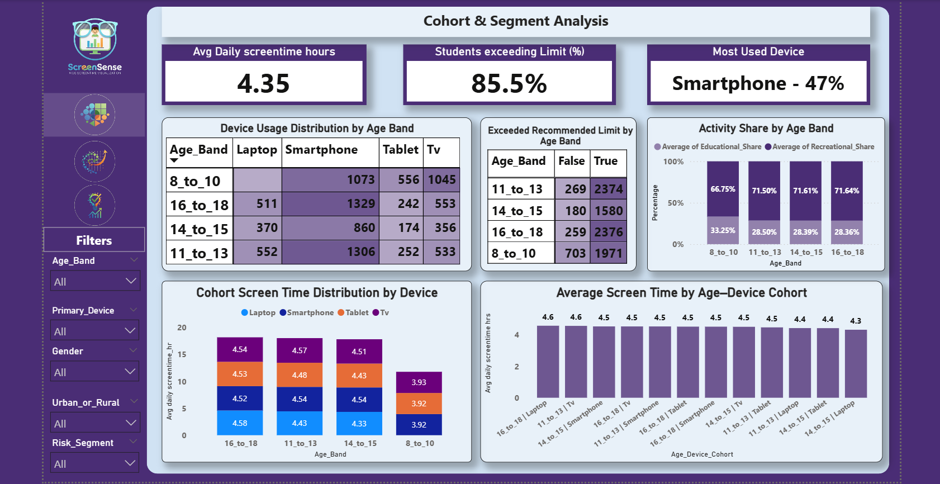
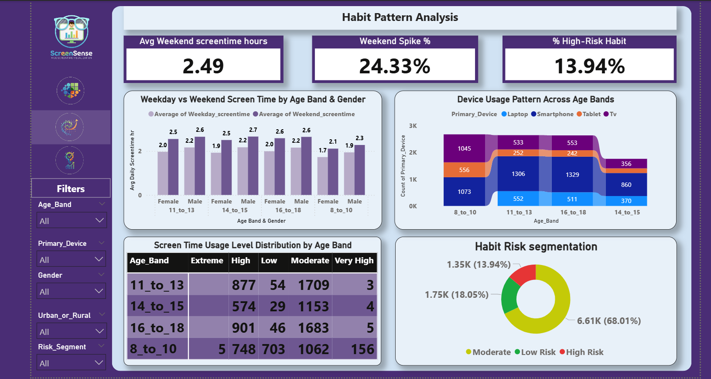
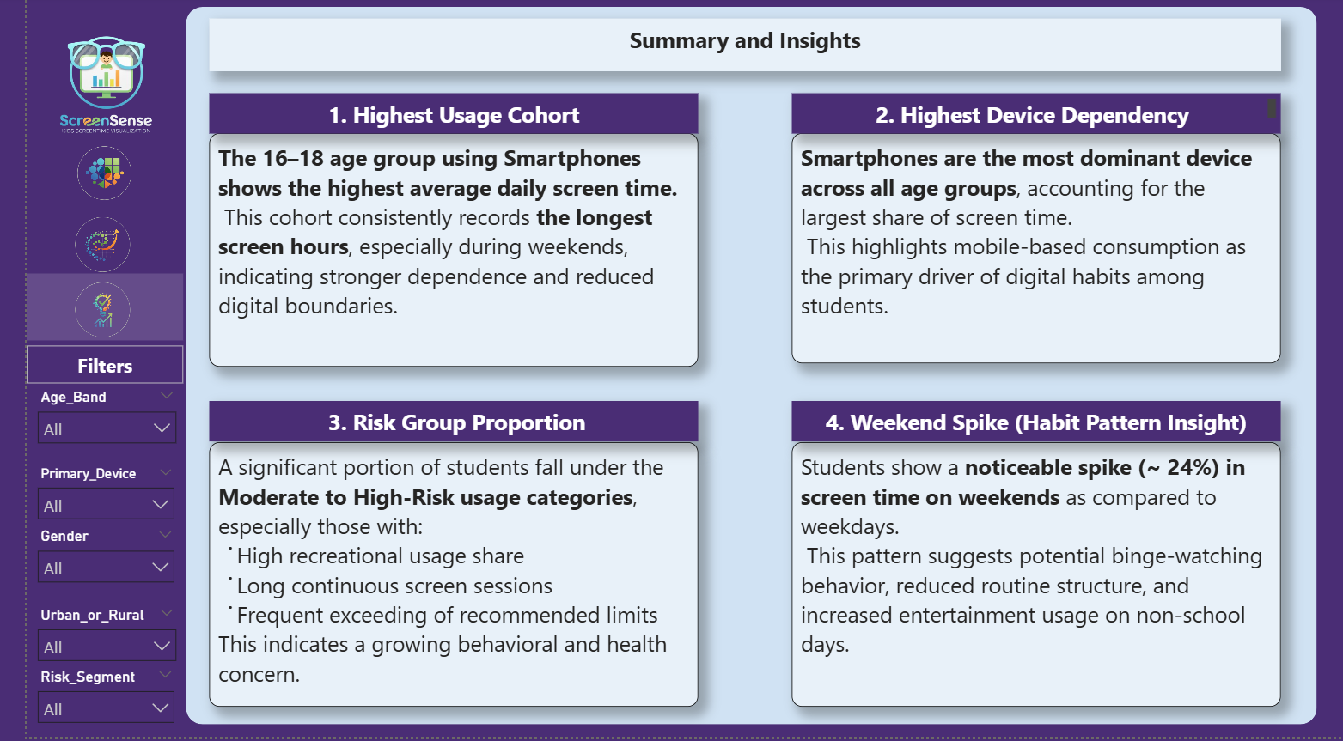
Final Output & Deliverables
Project Outputs:
Cleaned dataset
Visual analysis (20+ charts)
Full Power BI dashboard
Documentation (PDF/README)
Final presentation

Slide 10
Conclusion
This project provides a complete analysis of children's screentime behavior. It highlights risky groups, key trends, and device usage patterns.
Thank You!

